Slide 1
CHAPTER 8 | Part 1
Service Innovation and Design

Slide 2
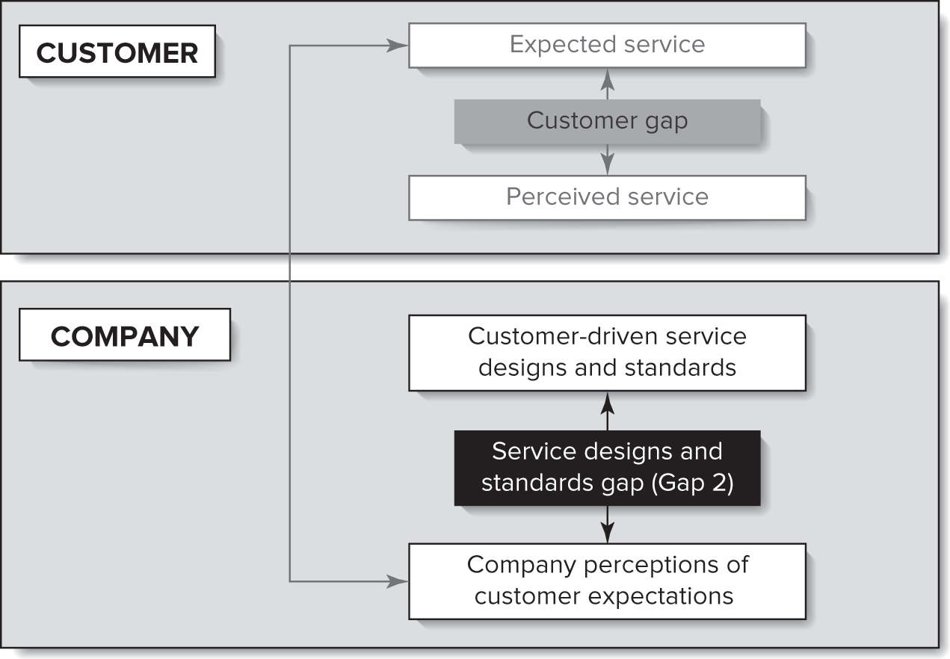
Service Design and Standards Gap

Slide 3
Chapter Objectives
Describe the challenges inherent to service innovation and design.
Present an array of different types of service innovations, including service offering innovation, innovating around customer roles, and innovation through service solutions.
Discuss the importance of engaging customers and employees and employing service design thinking.
Present the stages and unique elements of the service innovation and development process.
Demonstrate the value of service blueprinting as a technique for service innovation and design.

Slide 4
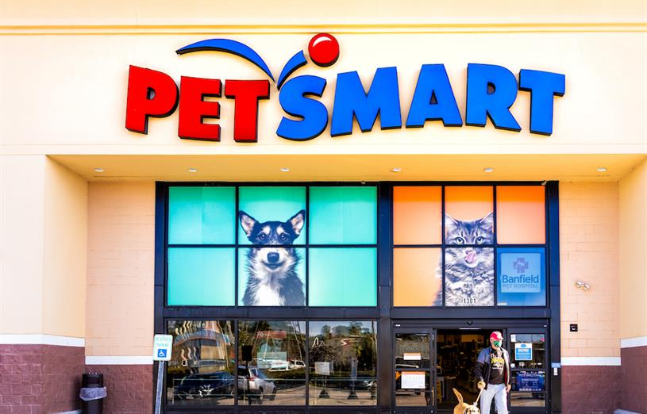
Why are some businesses more successful at introducing services than others?
Example: PetSmart moving from a warehouse of products to now focusing on pet services.

Slide 5
Characteristics of Successful Innovations
Product/ service characteristics: meeting customer needs, advantage over competing products, technological sophistication
Strategy characteristics: dedicated human resources to support, dedicated research and development
Process characteristics: marketing, predevelopment, technological, and launch proficiencies
Marketplace characteristics: market potential

Slide 6
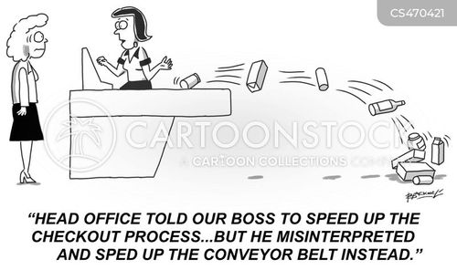
To sell a service you must describe it, but there are risks when describing a service
Oversimplification
Incompleteness
Subjectivity
Biased Interpretation
Notes:
Oversimplification: like describing the space shuttle as something that flies. Words are inadequate to describe a complex service system.
Incompleteness: when describing services, people tend to omit details they are not familiar with.
Subjectivity: anyone describing a service will be biased by their own experiences and exposure to the service. We all have our own opinions even in the same service!
Biased Interpretation: no two people will describe a service (or their experience) in the exact same way and how others interpret what is said will also vary.

Slide 7
Considerations for Service Innovation
Cocreative
Sequencing
Evidencing
Holistic
User-centered
Involve customers and employees
Employee Service Design Thinking and Techniques
Five principles of service design thinking
Notes:
Employees are on the service, customers co-create the service
User-centered: services should be experienced and designed through the customer’s eyes.
Cocreative: all stakeholders should be included in the service design process.
Sequencing: a service should be visualized as a sequence of interrelated actions.
Evidencing: intangible services should be visualized in terms of physical artifacts.
Holistic: the entire environment of a service should be considered.

Slide 8
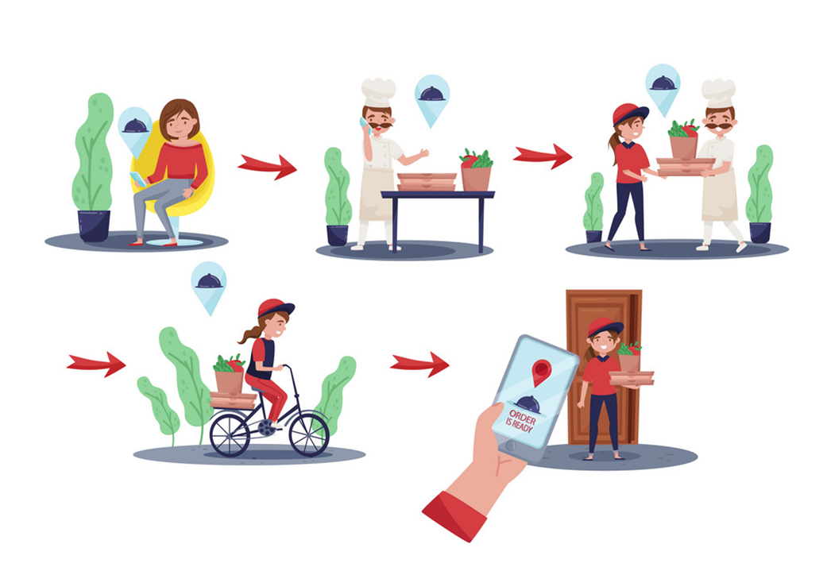
Example: Design a Food Delivery Service
Cocreative
Sequencing
Evidencing
Holistic
User-centered
Customers
Employees (including delivery partners)
Partner restaurants
Primarily students
Customer needs – what would this include (e.g., price)?
External environment
Regulators
Market potential
Web/ mobile application (what features are important here?)

Slide 9
What is a recent service (or product) innovation that you have seen?
Discussion Question
Notes:
https://www.nytimes.com/2025/01/23/technology/openai-operator-launch.html
https://www.youtube.com/watch?v=CSE77wAdDLg

Slide 10

Notes:
https://www.youtube.com/watch?v=vohYJ16FEcA

Slide 11
Discussion Questions
How can AI agents like Operator enhance customer experiences in service industries?
In what ways can businesses integrate AI agents into their existing service models without compromising their brand's unique voice and message?
What are the ethical considerations and potential risks associated with deploying AI agents in customer-facing roles?

Slide 12
Types of Service Innovations
We will review several types of service innovations.

Slide 13


Service Offering Innovation
Major or Radical Innovations
New services for markets that have not yet been defined.
Example: Amazon’s introduction of same-day and two-day delivery.
Often these major innovations create brand new markets.

Slide 14
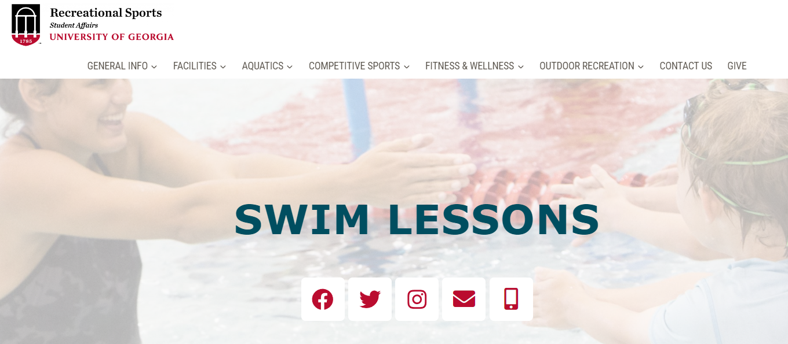
Service Offering Innovation
New Services for the Currently Served Market
Attempts to offer existing customers of the organization a service not previously available from the company (though it may be available from other companies).
Sometimes this is a stand-alone service like PetSmart Hotels and other times this is an enhancement like health club offering nutrition classes.

Slide 15
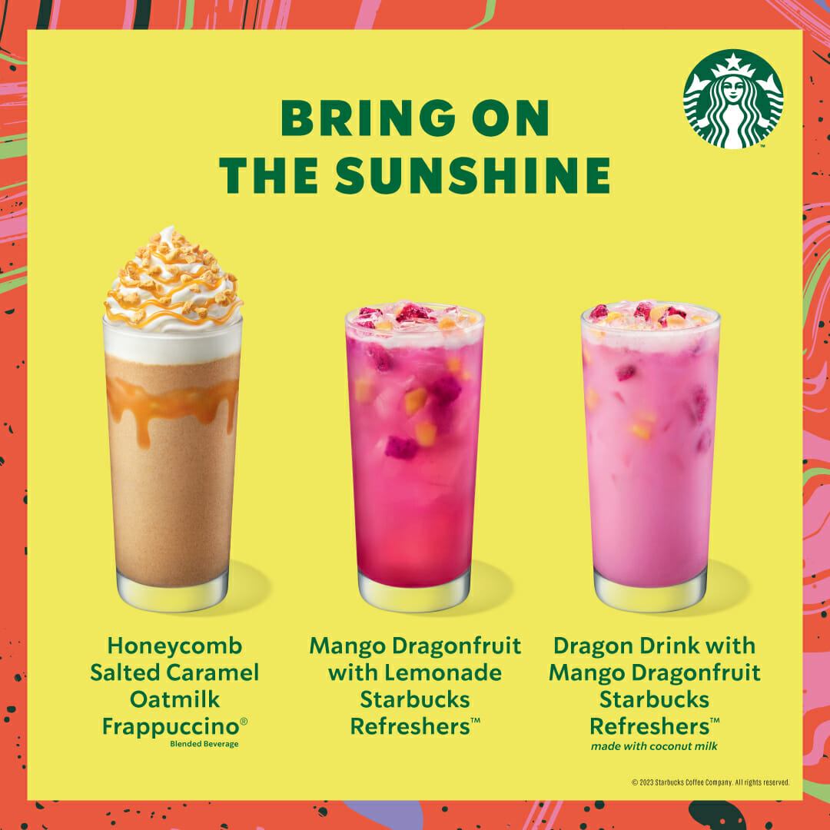

Service Offering Innovation
Service-line Extensions
Augmentations of the existing service line.
  Example: new menu items in restaurants; new routes on flights

Slide 16
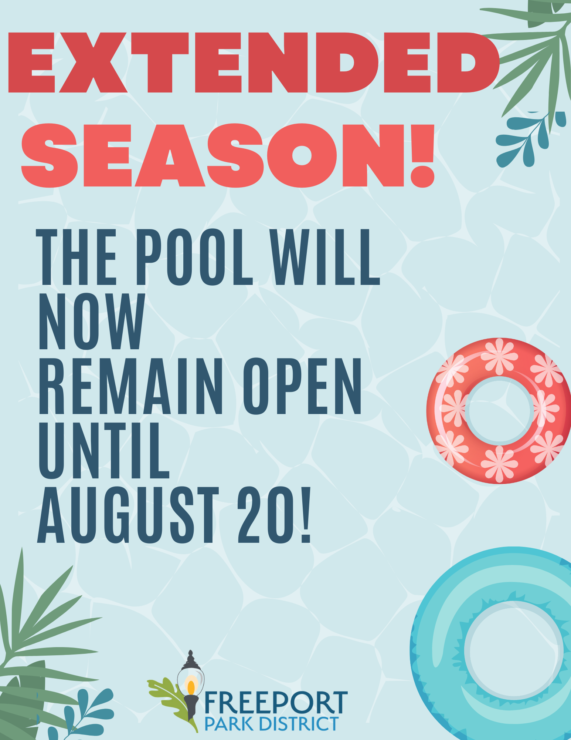
Service Offering Innovation
Service Improvements
The most common type of service innovation.
Changes in features of service already offered might involve faster execution of an existing service process.
  Example: extended operating hours

Slide 17

Service Offering Innovation
Style Changes
The most modest service innovation.
Highly visible and can have significant effects on customer perceptions, emotions, and attitudes.
  Example: changing the color of a logo or redesigning a website.

